Slide 1

User Intent Recognition
Artificial Intelligence

Slide 2

The challenge at hand is to create a robust AI model for user intent determination in Chatbots. This model must accurately classify diverse user inputs into specific intent categories and narrow down the set of intents, enabling effective responses.
Problem statement

Slide 3

The Solution
Crafting a precise AI model with advanced NLP techniques, trained on diverse intent datasets.
The model will narrow down the set of user intents by asking questions and based on the answers provided the set will be eventually narrowed down.

Slide 4
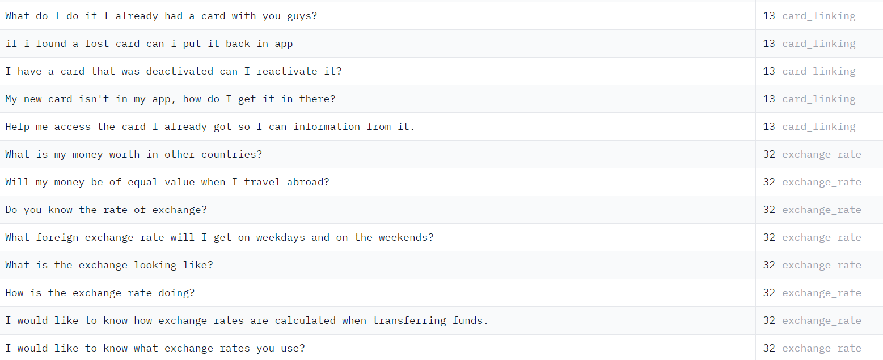
Dataset Used - Banking77 (HuggingFace)

Slide 5
Algorithm (Planning)
Initialization:
Define a set S containing all possible user intents.
Set a probability threshold T_{initial} ​ for NLP text matching.
NLP Text Matching:
Remove intents from S with matching probabilities below T_{initial} ​ based on initial user input.
Response Generation:
Utilize a Language Model (LLM) to generate responses for each intent in the refined set S.

Slide 6
Algorithm (Planning)
User Query Processing:
Receive and process user queries after LLM responses.
Update set S to a new set S′ based on user feedback.
Intent Confirmation Loop:
Generate a set of K questions to ask the user.
Ask the user the questions and record their responses. If the answers confirm the intent, proceed to the next step.
Final Intent Confirmation:
If only few intents remains in S′ after the confirmation loop, consider these as the final user intent. If large number of intents remain, request additional clarification from the user.

Slide 7
Data Collection and Training: Gather a diverse dataset of user inputs paired with corresponding intent labels, spanning various relevant domains.
Feature Extraction: Preprocess and transform the text utilizing techniques like word embeddings and lemmatizer.
Initial Intent Detection: Determine the probability of user intents using NLP on the user query for every class of intents.
Planning: Discard some of the user intents based on a experimentally chosen threshold for probability and broaden the set of user intents by asking further questions.
Running on Large Real Dataset: Implement the model in a real-time environment and continuously update the response to adapt to changing language patterns.
Methodology

Slide 8
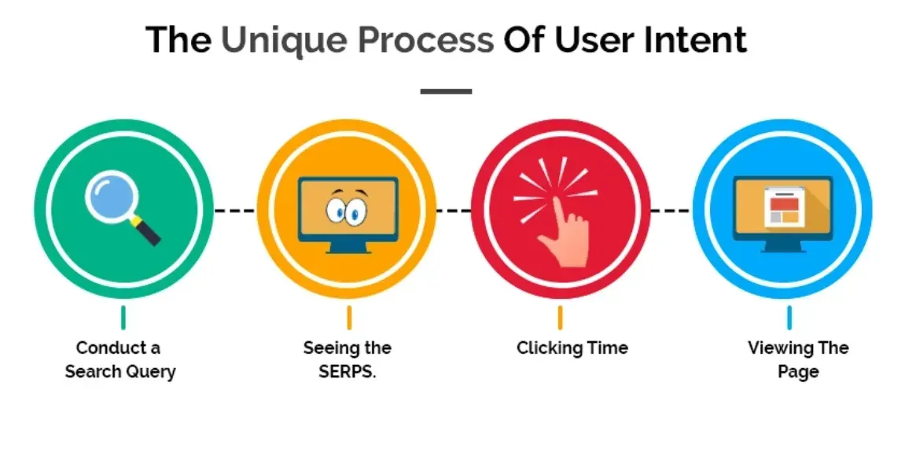
Query
Input
Bot
Response
Intents
Narrowing
Final
Possible

Slide 9
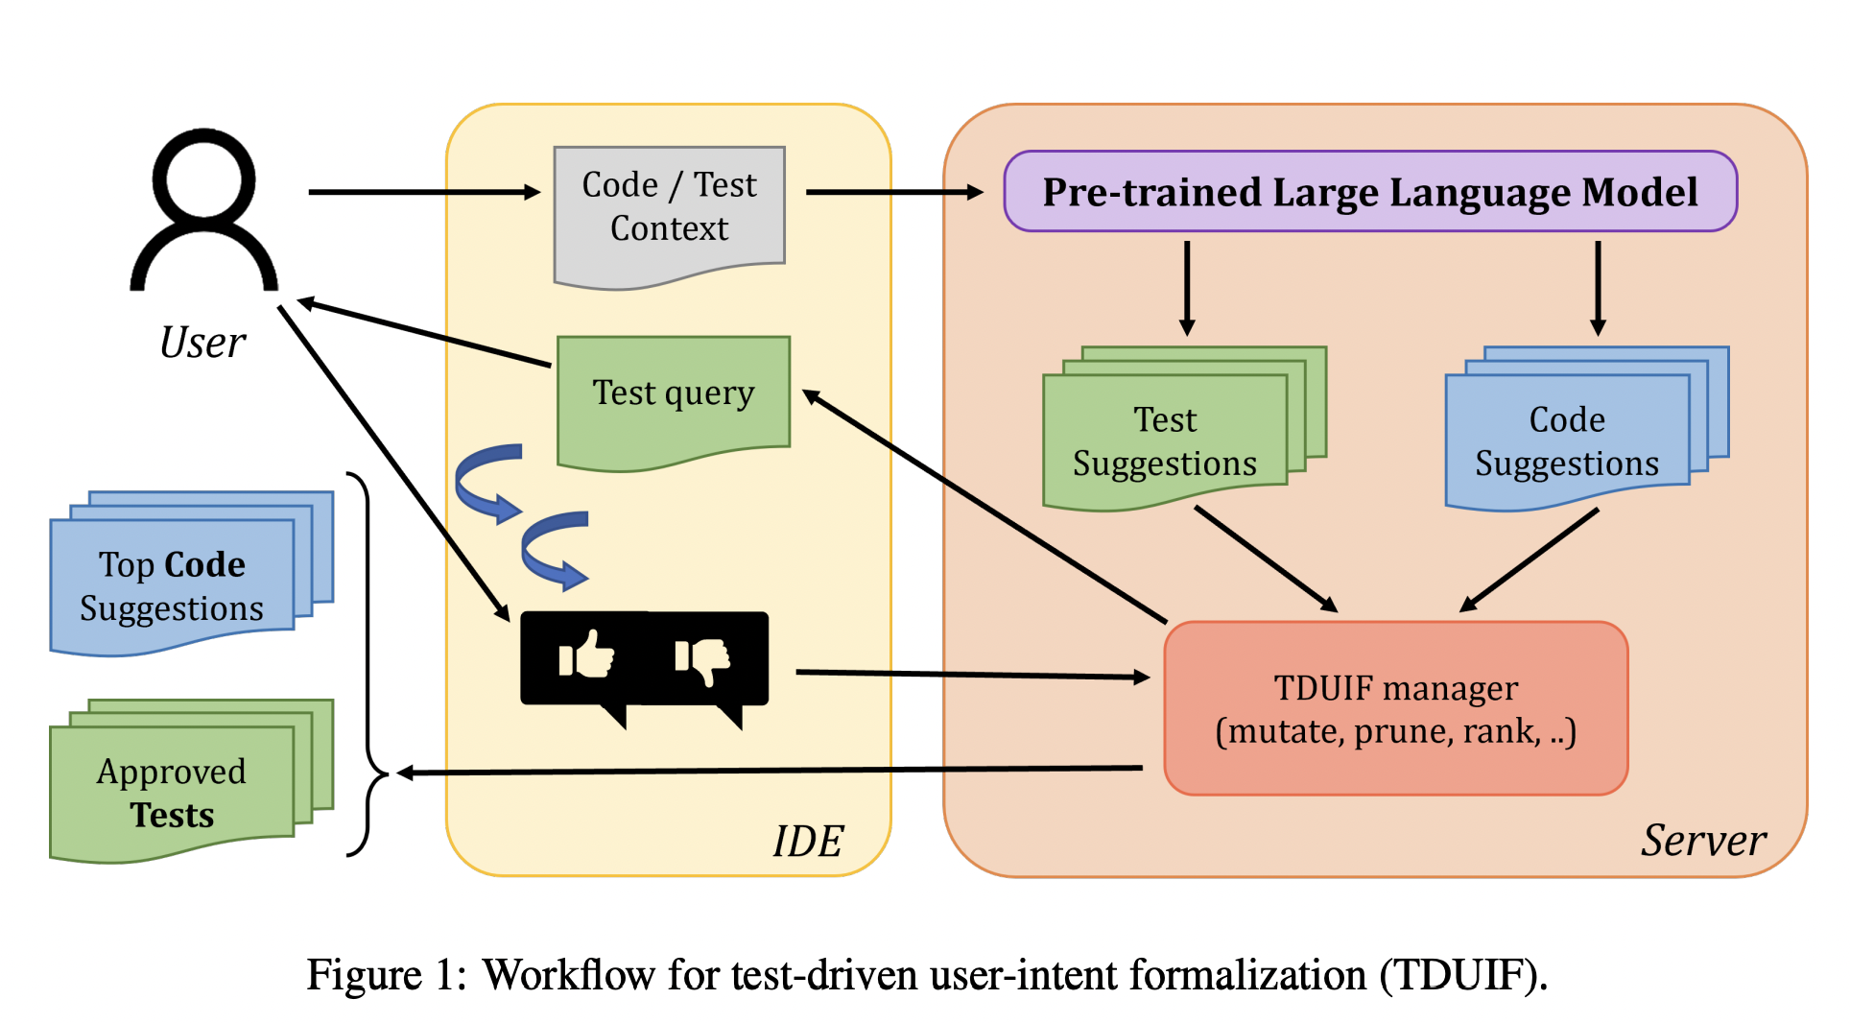
Workflow

Slide 10


Slide 11
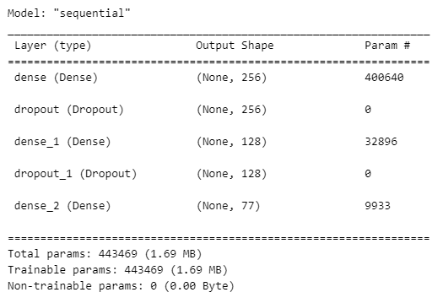
Model Summary

Slide 12


LLM Generated Questions

Slide 13
Intent Set Compression
Query1: I have lost my card, close account, stop and decline card transaction and transfer.
Intents1 = card_lost, terminate_account, card_not_working, declined_transfer
Query2: Stop my transfer because I lost card.
Intents2 = card_lost, declined_transfer
Query3: I have lost card, My account details are XXXX.
Intents3 = card_lost

Slide 14


Slide 15
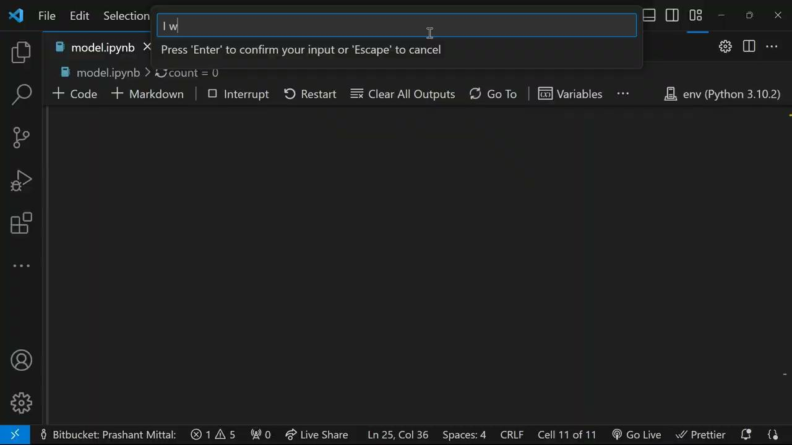

Slide 16
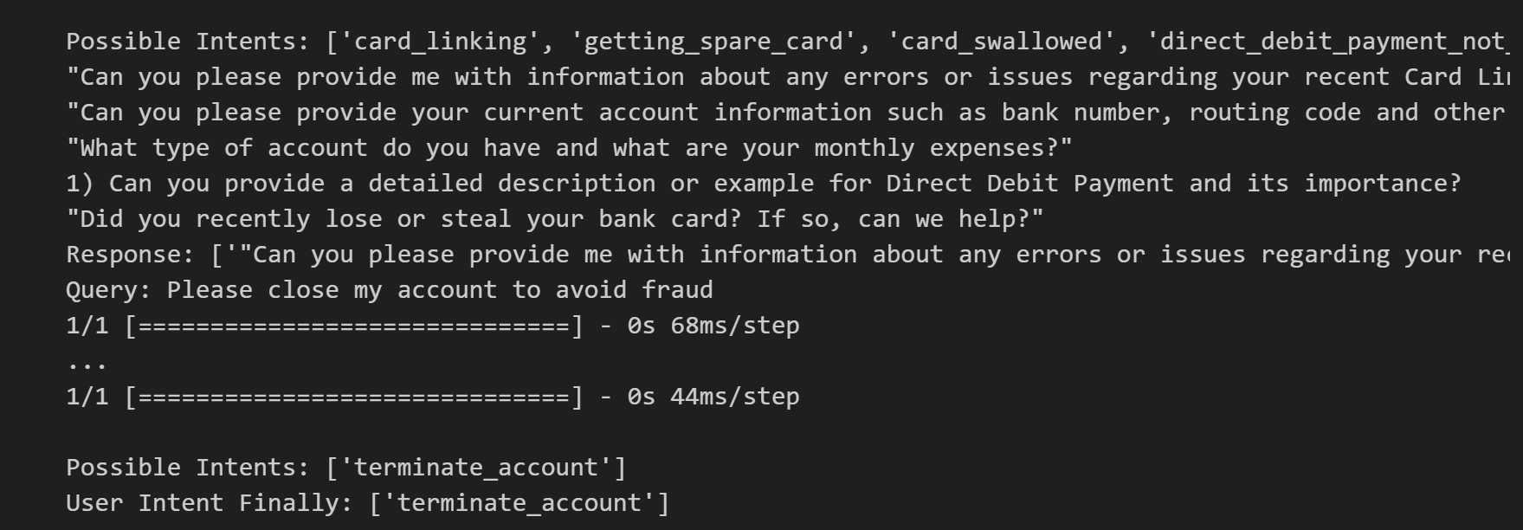

Slide 17

USE CASES
E-commerce Recommendations
Healthcare Chatbots
Content Filtering
Automated Customer Support
Financial Services

Slide 18
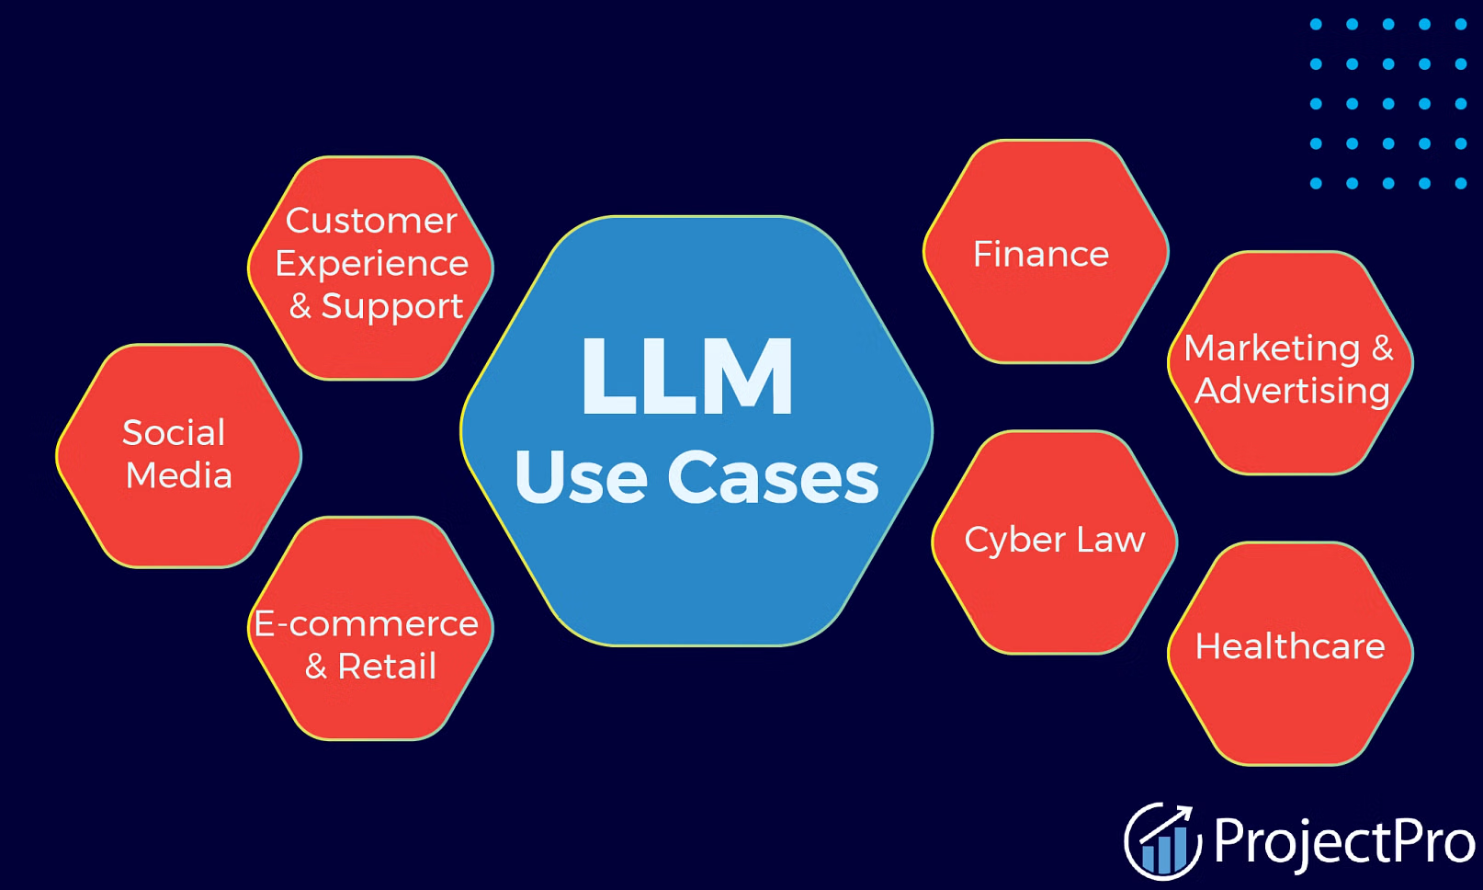

Slide 19

References
Dataset - HuggingFace
LLM Integration - Medium
Use Case - ResearchGate

Slide 20

Thank you

